Slide 1
ESPAD Report 2015
Results from the European School Survey Project on Alcohol and Other Drugs
ESPAD Group
Lisbon, 20 September 2016

Slide 2
ESPAD data collections
Europe’s largest harmonised data collection on substance use
    26 countries in 1995
    30 countries in 1999
    35 countries in 2003
    35 countries in 2007 (plus 5 in 2008)
    39 countries in 2011
    35 countries in 2015
    46 European countries have participated
Notes:
46 European countries have participated in at least one ESPAD wave.

Slide 3
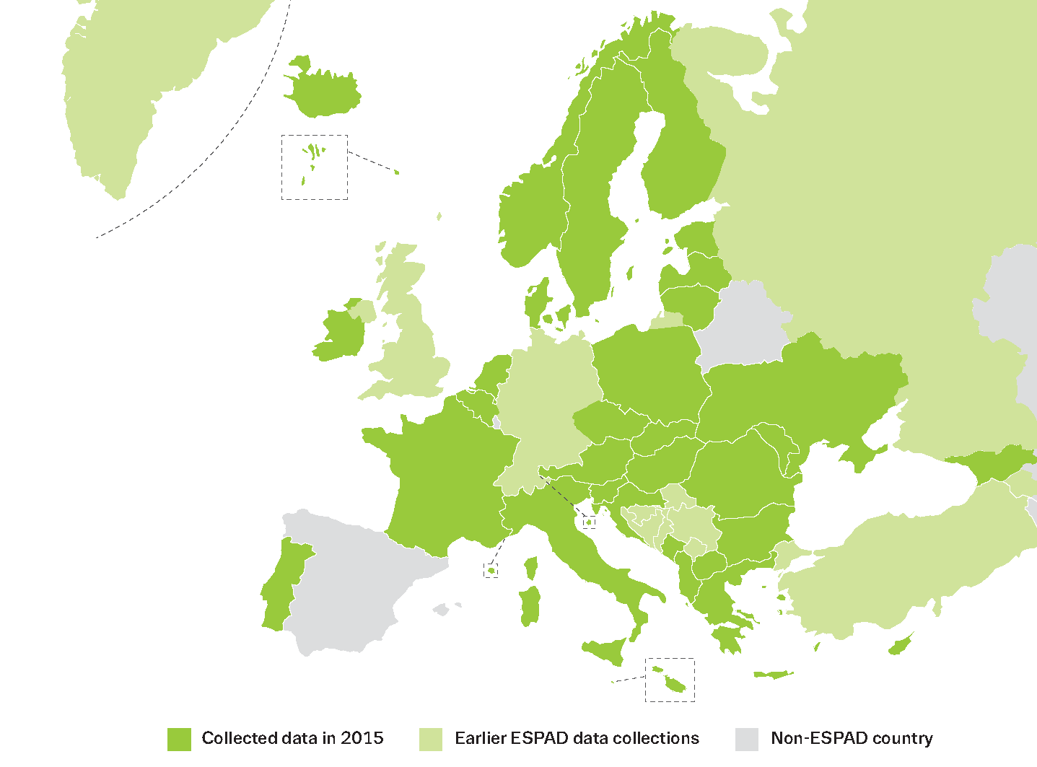
Countries in the ESPAD project
(Countries that have participated in at least one wave of ESPAD)

Slide 4
ESPAD 2015
    35 European countries
    96 043 students (15-16 years old)
    In the 6 waves of data collection (1995, 1999,
    2003, 2007, 2011 and 2015) about 600 000
    students have participated

Slide 5
Countries dropping out and joining in 2015
    Dropping out in 2015
    Bosnia and Herzegovina (FBiH and RS)
    Isle of Man
    Kosovo (under UNSCR 1244)
    Russian Federation (Moscow)
    Serbia
    Germany (only participation of some Bundesländer in previous
    surveys) → worrying
    United Kingdom (non-participating schools) → worrying
    Joining (or re-joining) in 2015
    Austria
    Georgia
    Former Yugoslav Republic of Macedonia

Slide 6
Ongoing developments in ESPAD
    In 2013, the Swedish government announced
    discontinuation of support for the coordination after
    2015.
    Increasing collaboration and support from the
    EMCDDA, including production of 2015 Report.
    The EMCDDA has committed to support the
    coordination for next cycle of ESPAD
    (2017-2020).

Slide 7
ESPAD 2015 results
Notes:
Latvia not included in 2015 averages due to comparability issues
Trend graphics (1995-2015) are based on the 25 countries that participated
in at least 4 waves (one of them being the last one)
The scale in the Y axis is adapted to the data presented to make the trends of interest more visible

Slide 8
Perceived availability

Slide 9
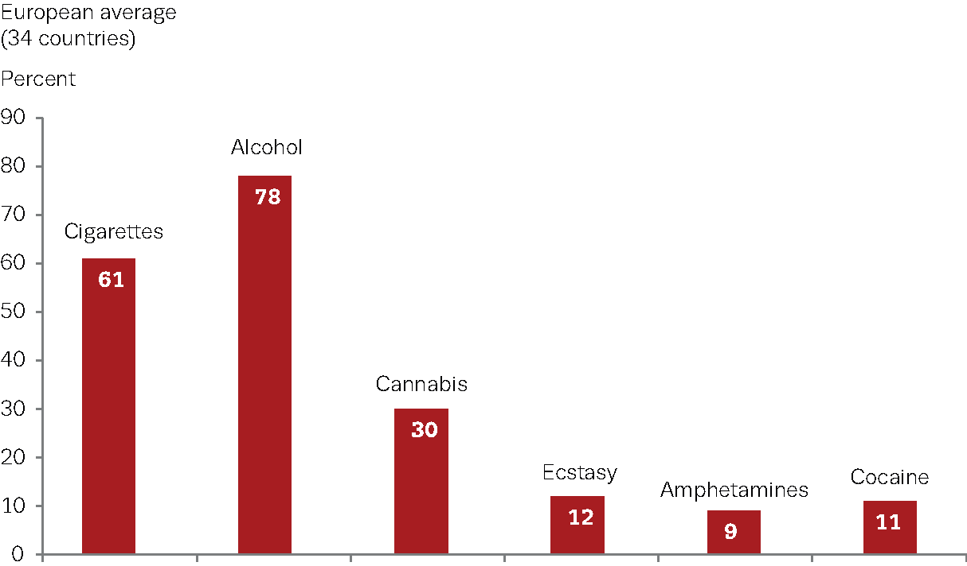
Perceived availability of substances
Students responding that it is ‘fairly easy’ or ‘very easy’ to obtain substances (percentage)

Slide 10
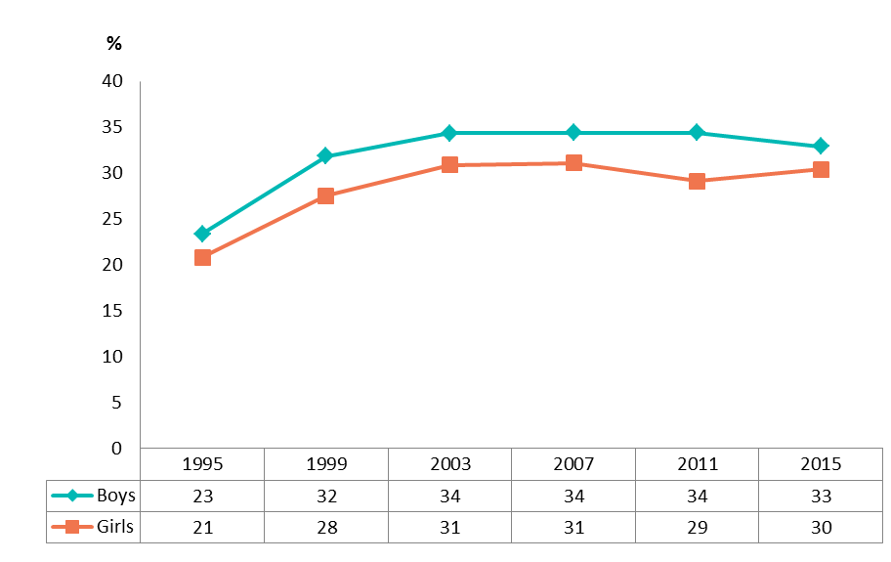
Perceived availability of cannabis use, by gender
Students responding that it is ‘fairly easy’ or ‘very easy’ to obtain cannabis —
25-country trend 1995-2015 (percentage)

Slide 11
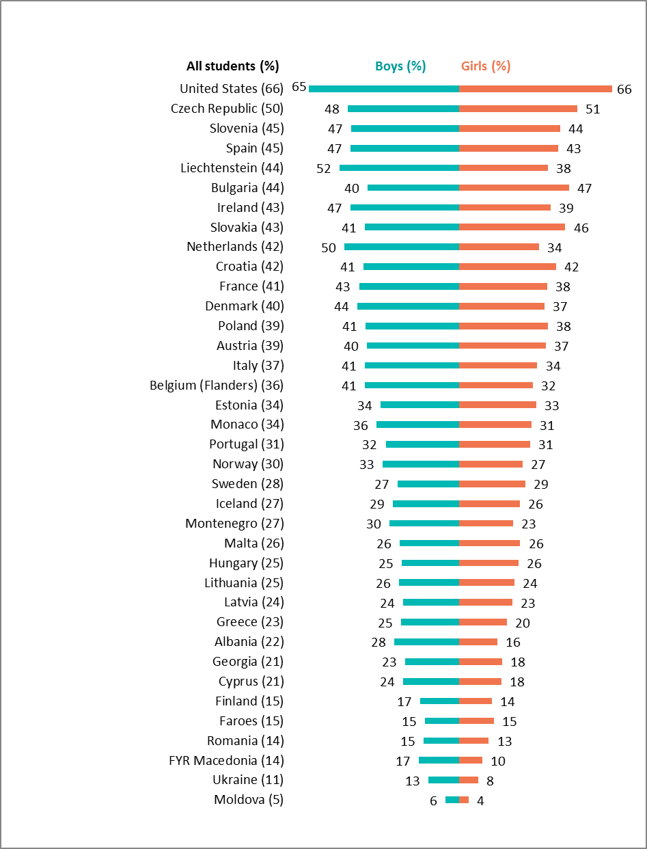
Perceived availability of cannabis
Students responding that it is ‘fairly easy’ or ‘very easy’ to obtain cannabis, by gender (percentage)
Notes:
The intention is not to read countries individually but to illustrate the range of variation of the values between countries

Slide 12
Early onset of use of
selected substances

Slide 13
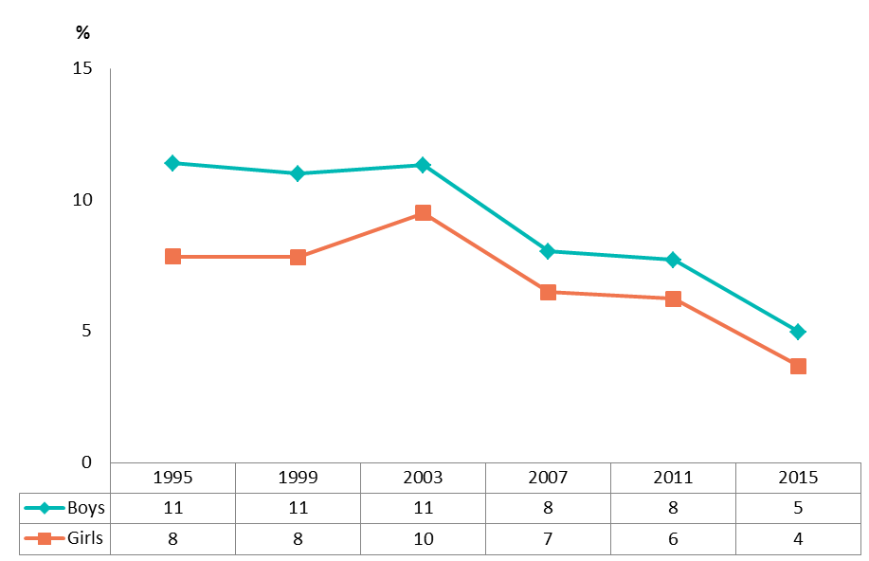
Daily cigarette use at the age of 13 or younger, by gender
25-country trend 1995-2015 (percentage)

Slide 14
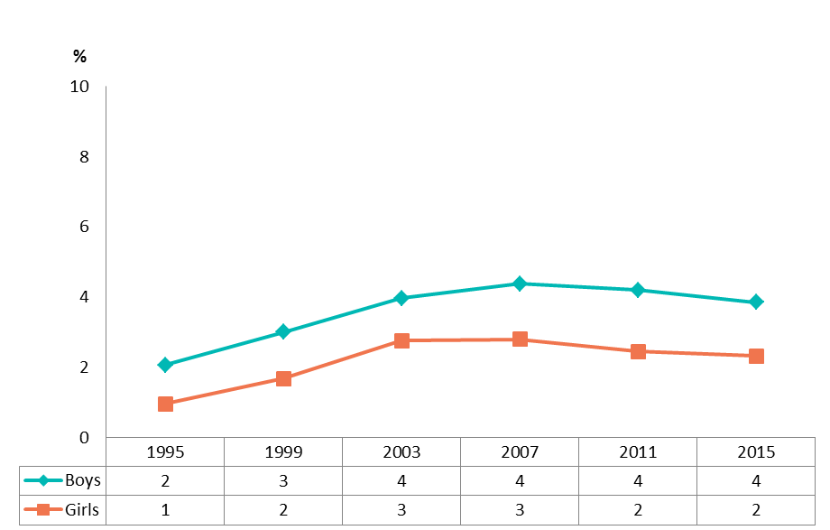
Cannabis use at the age of 13 or younger, by gender
25-country trend 1995-2015 (percentage)

Slide 15
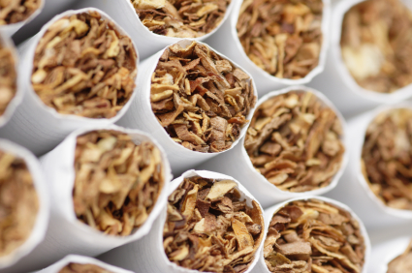
Cigarettes

Slide 16
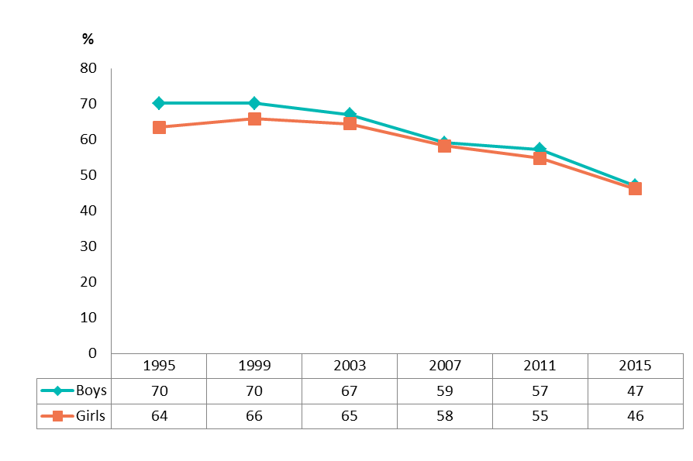
Lifetime use of cigarettes, by gender
25-country trend 1995-2015 (percentage)

Slide 17
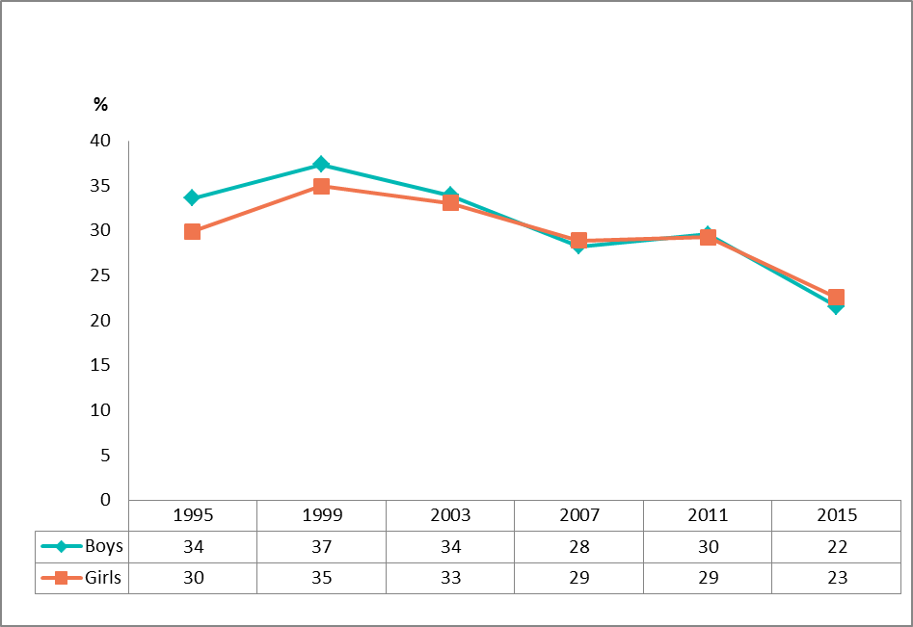
Cigarette use in the last 30 days, by gender
25-country trend 1995-2015 (percentage)

Slide 18
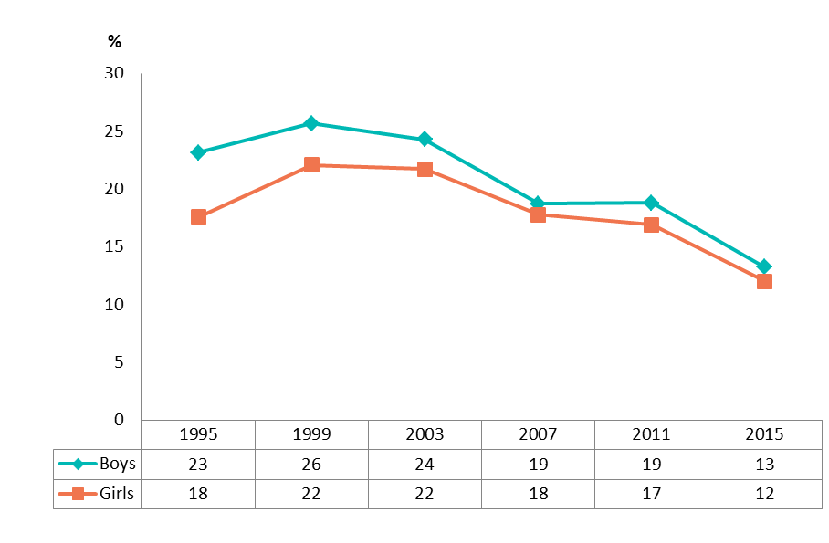
Daily cigarette use in the last 30 days, by gender
25-country trend 1995-2015 (percentage)

Slide 19
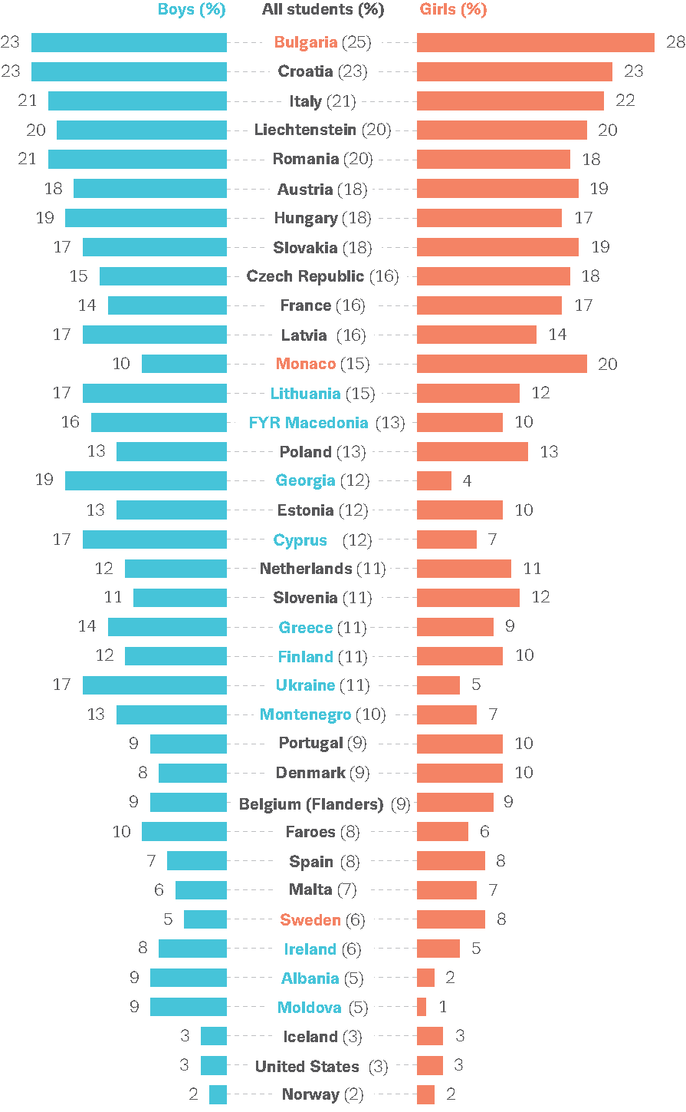
Daily cigarette use
Prevalence in the last 30 days, by gender (percentage)
Notes:
- The intention is not to read countries individually but to illustrate the range of variation of the values between countries.
- Colour indicates significant difference between boys and girls (not tested for Spain and United States).
- Belgium (Flanders), Cyprus and Moldova: limited geographical coverage.
- Latvia, Spain and United States: limited comparability.

Slide 20
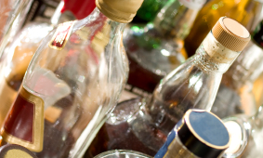
Alcohol

Slide 21
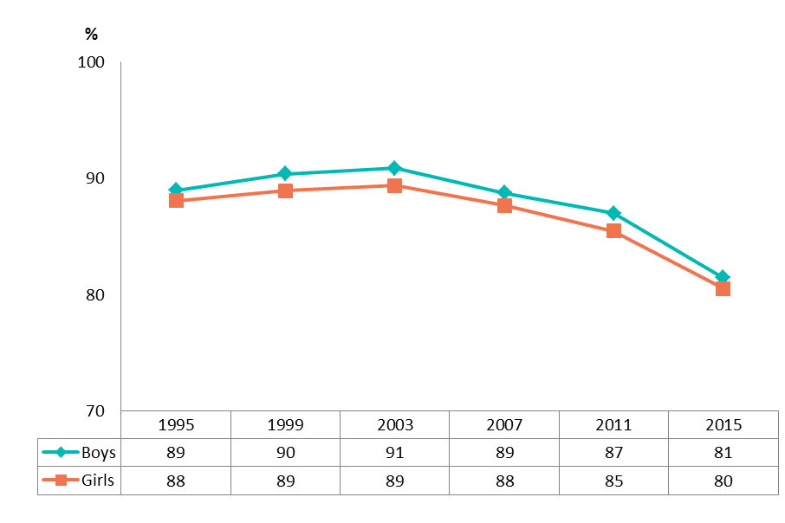
Lifetime alcohol use, by gender
25-country trend 1995-2015 (percentage)
Notes:
Note: Scale does not start at 0 % but at 70 % to visualise better the decrease.

Slide 22
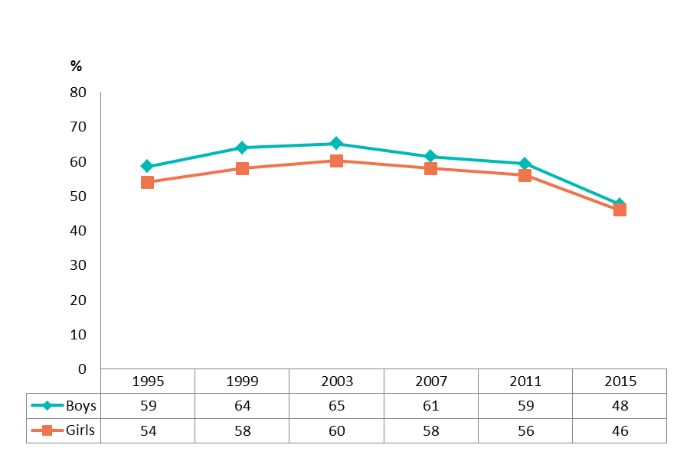
Alcohol use in the last 30 days, by gender
25-country trend 1995-2015 (percentage)

Slide 23
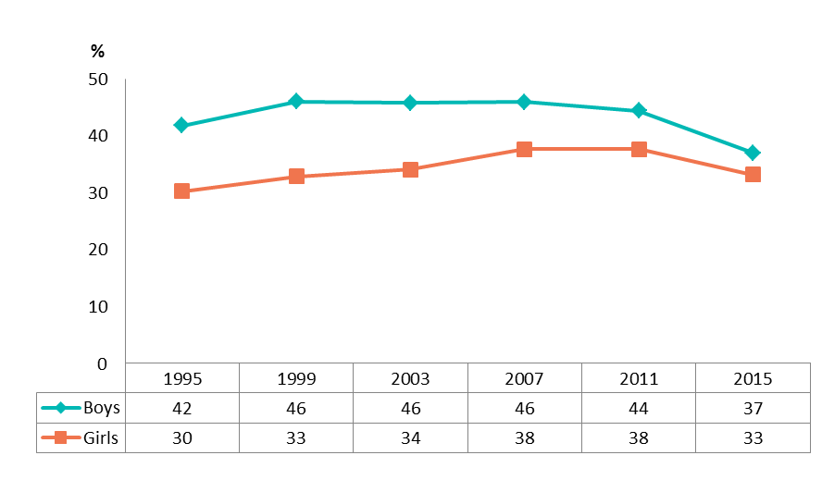
Heavy episodic drinking during the last 30 days, by gender
Five or more drinks on one occasion. 25-country trend 1995-2015 (percentage)
Notes:
Increases in the first years (in particular for girls) with a narrowing of the gender gap.
Marked decreases between 2011 and 2015, in particular among boys with a further decrease in the gender gap.

Slide 24
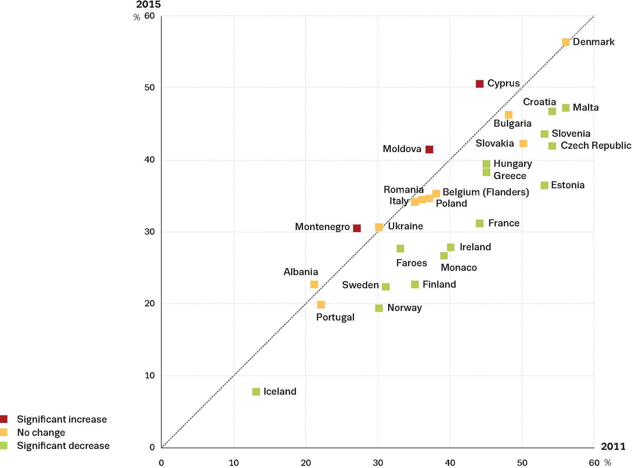
Changes between 2011 and 2015 in the proportion reporting having had five or more drinks on one occasion during the past 30 days (percentage)
Notes:
Note: National examples are given so that a ‘drink’ is understood to contain roughly the equal amount of pure alcohol as a glass of wine.

Slide 25
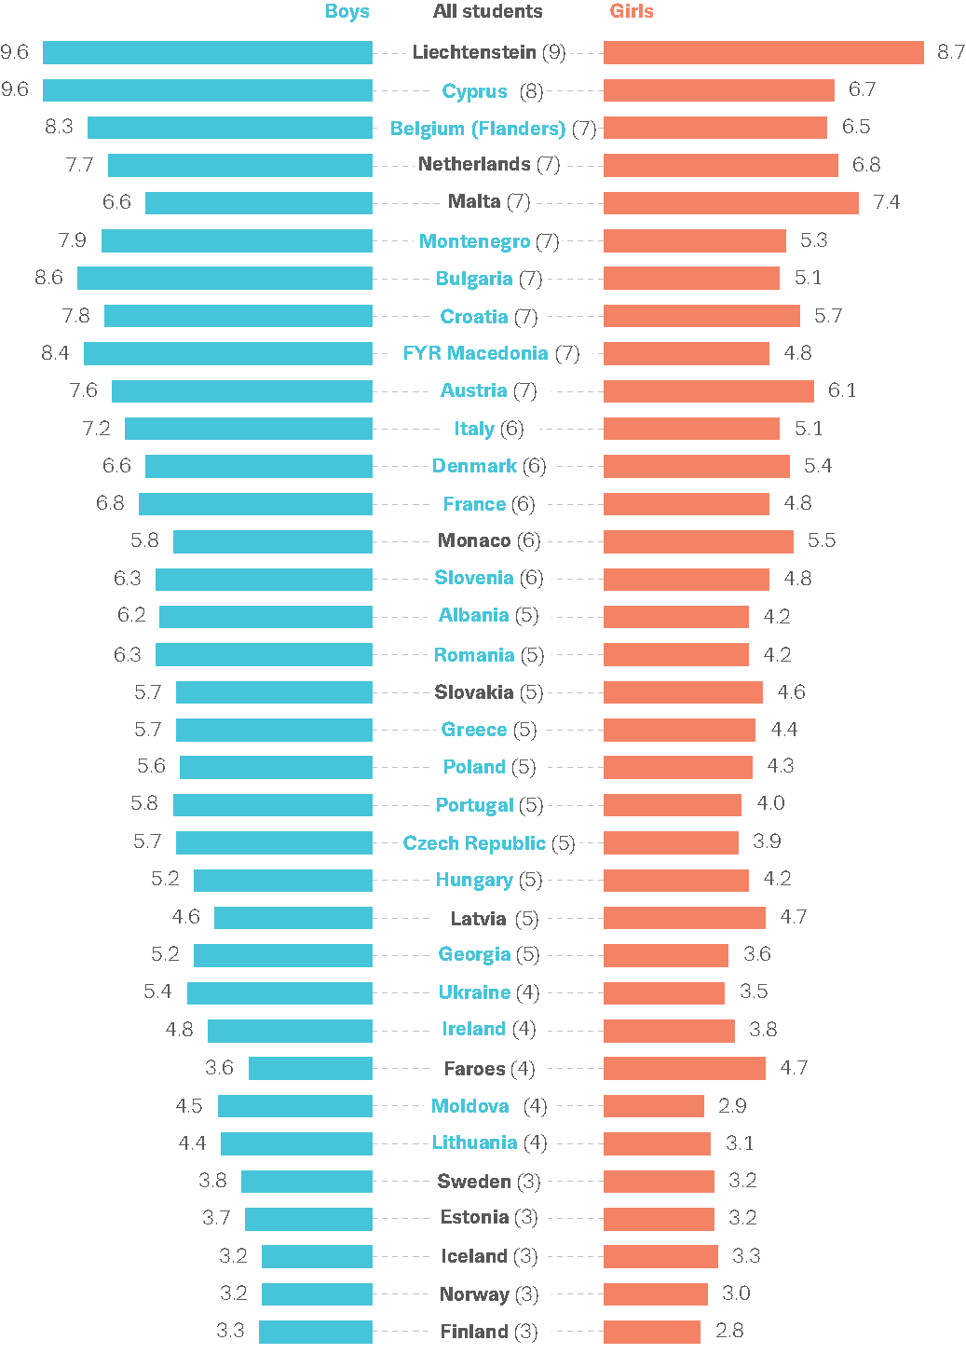
Average frequency of alcohol intake in the last 30 days, by gender (mean number of occasions among users)
Notes:
- The intention is not to read countries individually but to illustrate the range of variation of the values between countries.
- Colour indicates significant difference between boys and girls.
- Belgium (Flanders), Cyprus and Moldova: limited geographical coverage.
- Latvia: limited comparability.

Slide 26
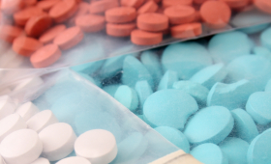
Illicit drugs

Slide 27
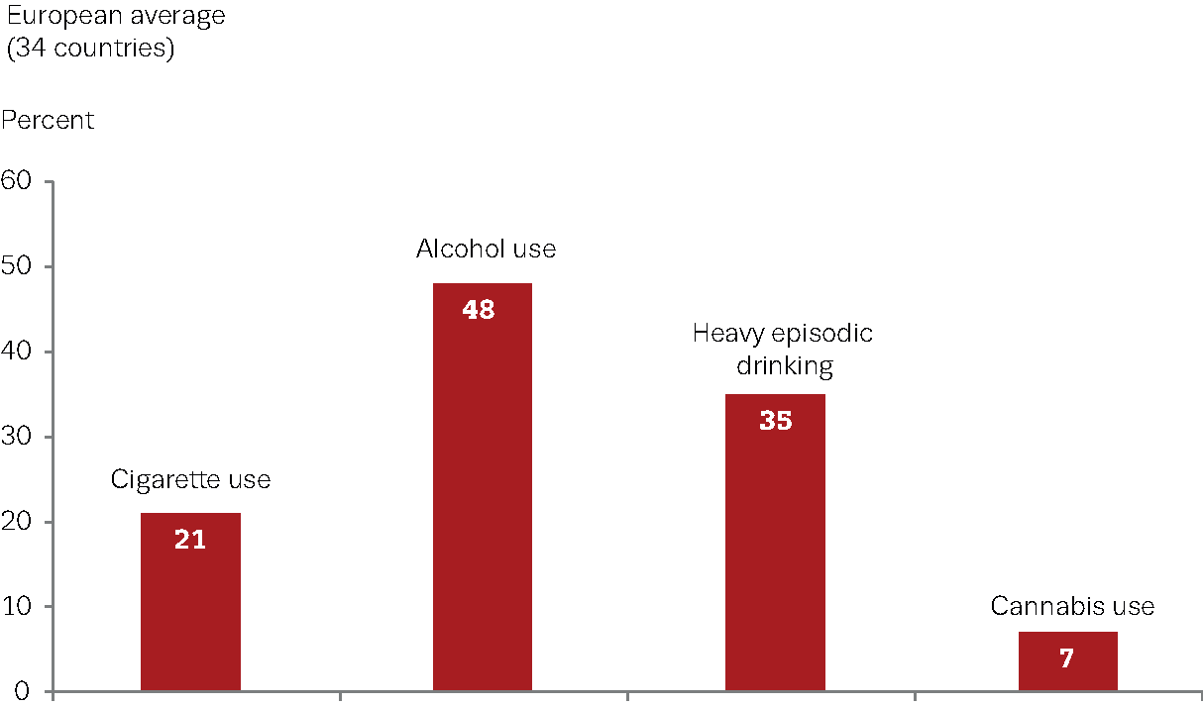
Last 30 days use for selected substances or patterns of use (percentage)

Slide 28
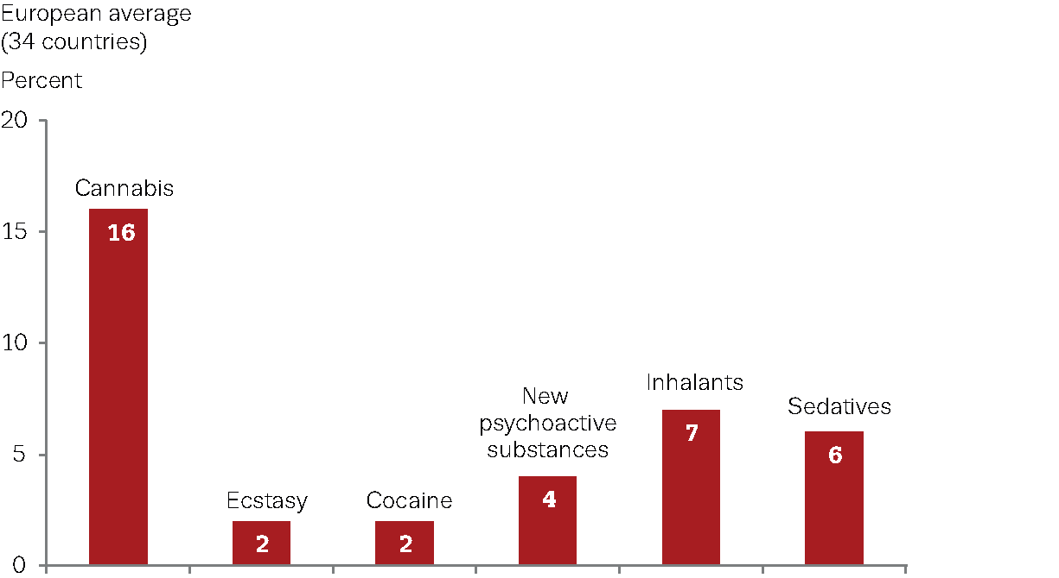
Lifetime prevalence of use of selected substances (percentage)

Slide 29
Slide double: Perceived availability of cannabis
Students responding that it is ‘fairly easy’ or ‘very easy’ to obtain cannabis, by gender (percentage)
Notes:
The intention is not to read countries individually but to illustrate the range of variation of the values between countries

Slide 30
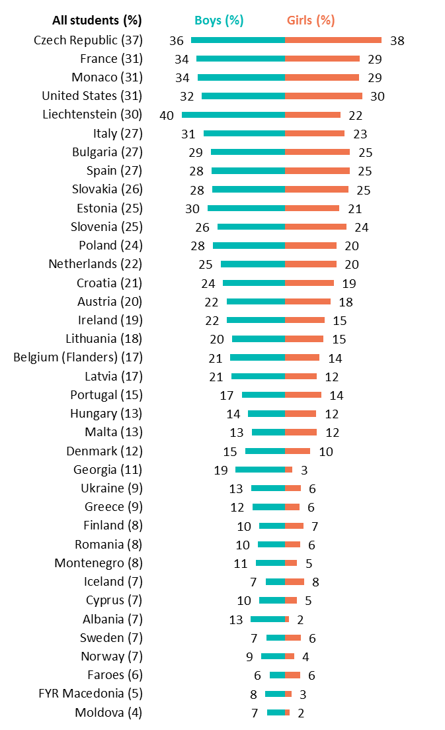
Lifetime prevalence of cannabis use, by gender (percentage)

Slide 31
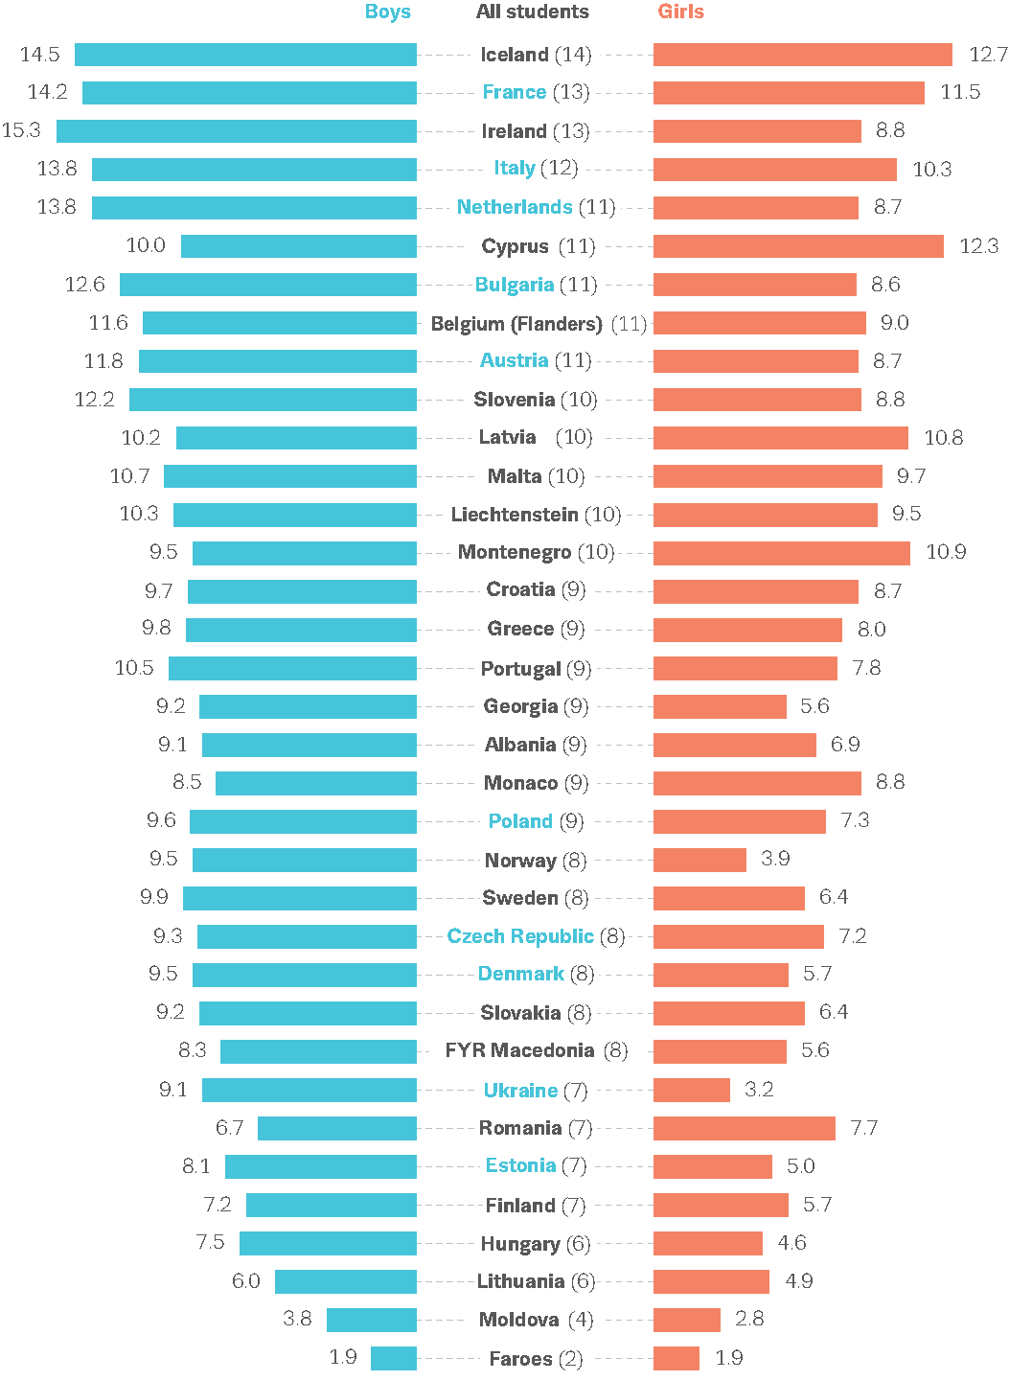
Average frequency of cannabis use in the last 12 months, by gender (mean number of occasions among users)
Notes:
The intention is not to read countries individually but to illustrate the range of variation of the values between countries.
- Colour indicates significant difference between boys and girls.
- Belgium (Flanders), Cyprus and Moldova: limited geographical coverage.
- Latvia: limited comparability.

Slide 32
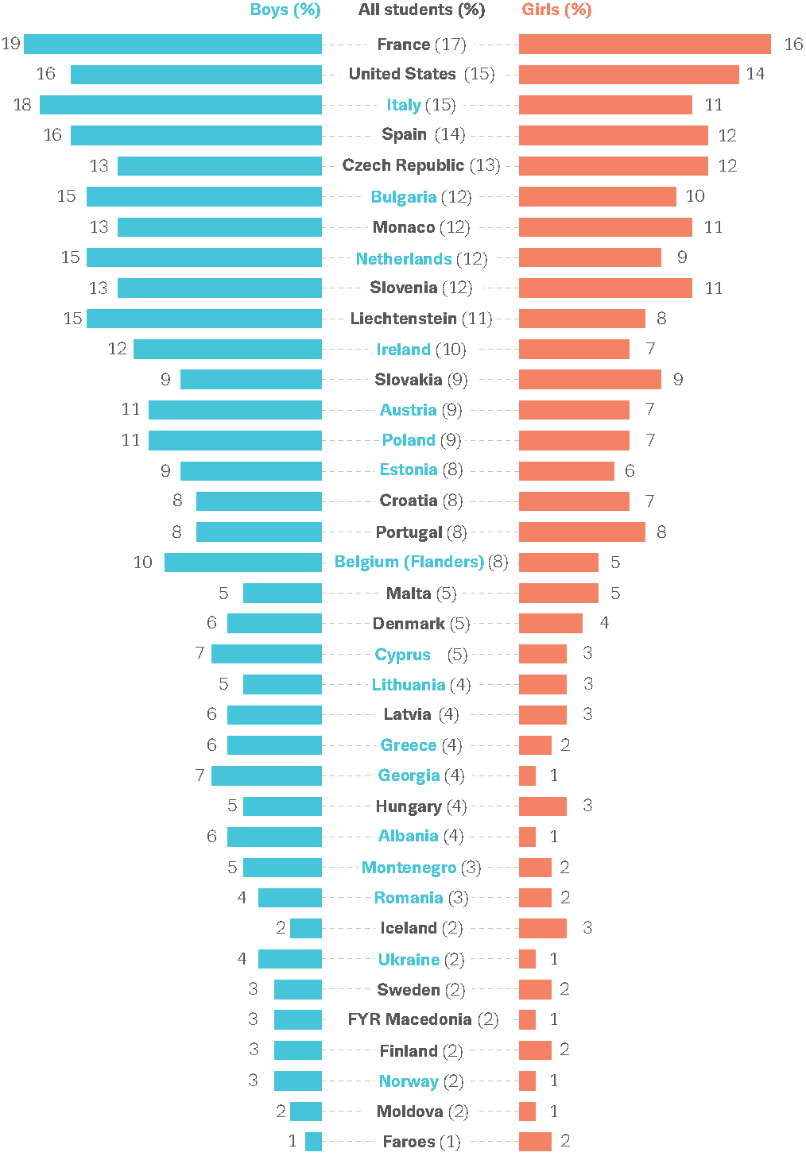
Prevalence of cannabis use in the last 30 days, by gender (percentage)
Notes:
- Colour indicates significant difference between boys and girls (not tested for Spain and United States).
- Belgium (Flanders), Cyprus and Moldova: limited geographical coverage.
- Latvia, Spain and United States: limited comparability.

Slide 33
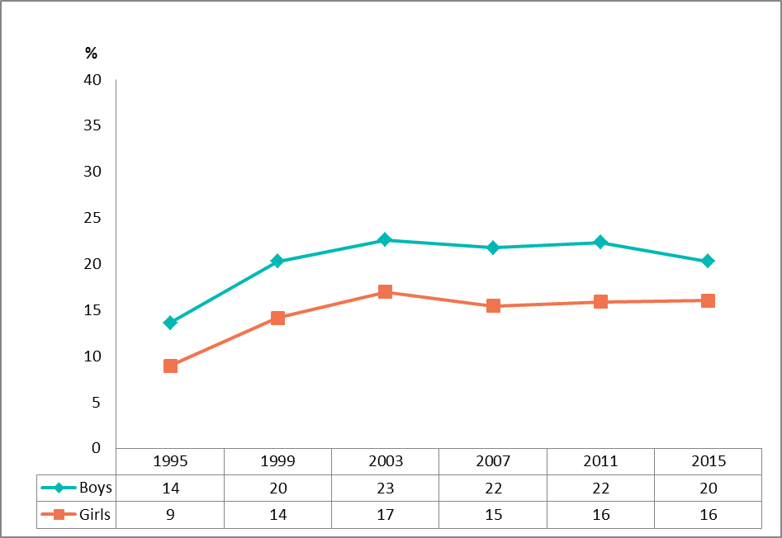
Lifetime use of illicit drugs, by gender
25-country trend 1995-2015 (percentage)
Notes:
Note: Trend data includes cannabis, amphetamine, cocaine, crack, ecstasy, LSD or other hallucinogens, heroin and (since 2007) GHB. Crack not included 2015 in Denmark, Estonia, Finland and Sweden.

Slide 34
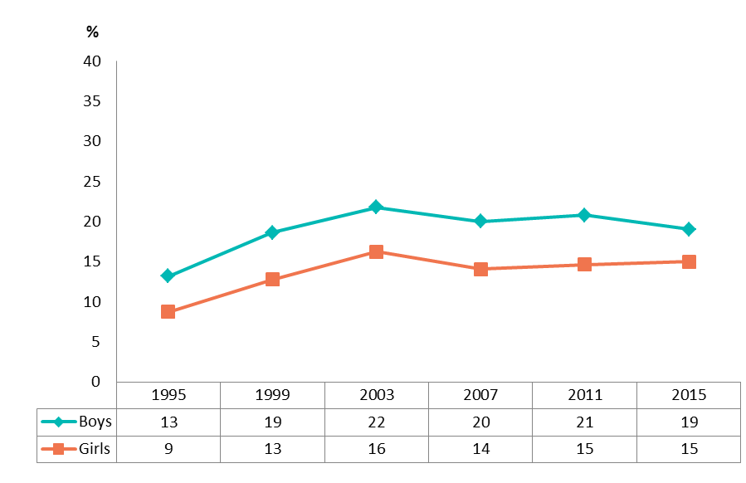
Lifetime use of cannabis, by gender
25-country trend 1995-2015 (percentage)

Slide 35
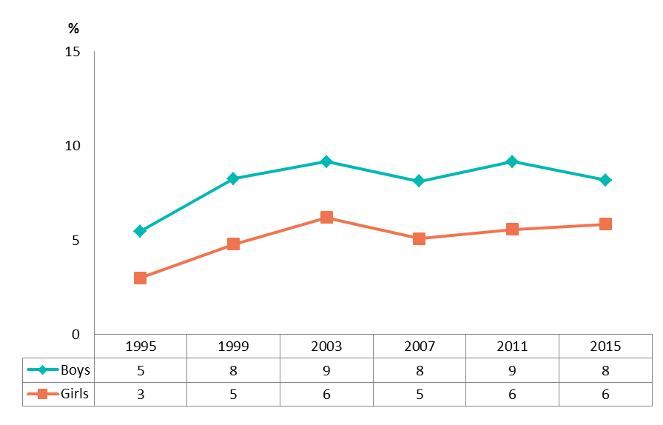
Cannabis use in the last 30 days, by gender
25-country trend 1995-2015 (percentage)

Slide 36
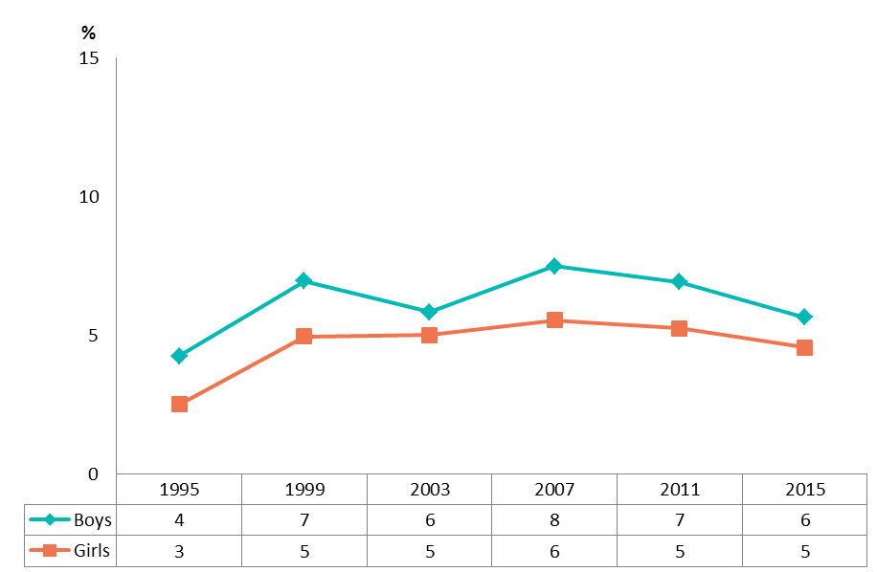
Lifetime use of illicit drugs other than cannabis, by gender
25-country trend 1995-2015 (percentage)
Notes:
Note: Trend data includes amphetamine, cocaine, crack, ecstasy, LSD or other hallucinogens, heroin and (since 2007) GHB. Crack not included 2015 in Denmark, Estonia, Finland and Sweden.

Slide 37
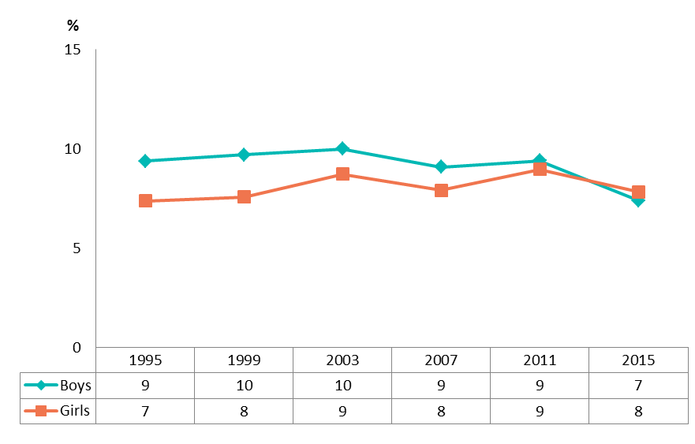
Lifetime use of inhalants, by gender
25-country trend 1995-2015 (percentage)

Slide 38
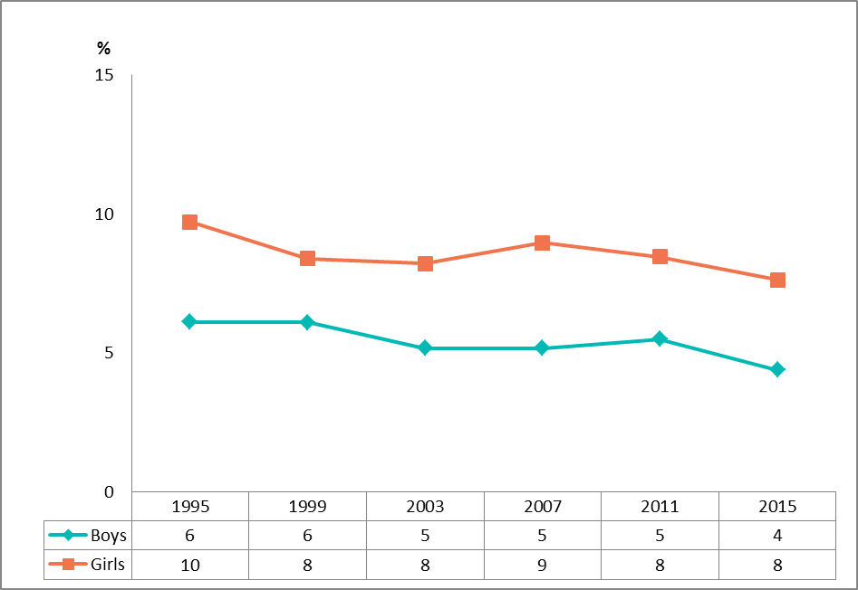
Lifetime use of tranquillisers or sedatives without a doctor’s prescription, by gender
25-country trend 1995-2015 (percentage)

Slide 39
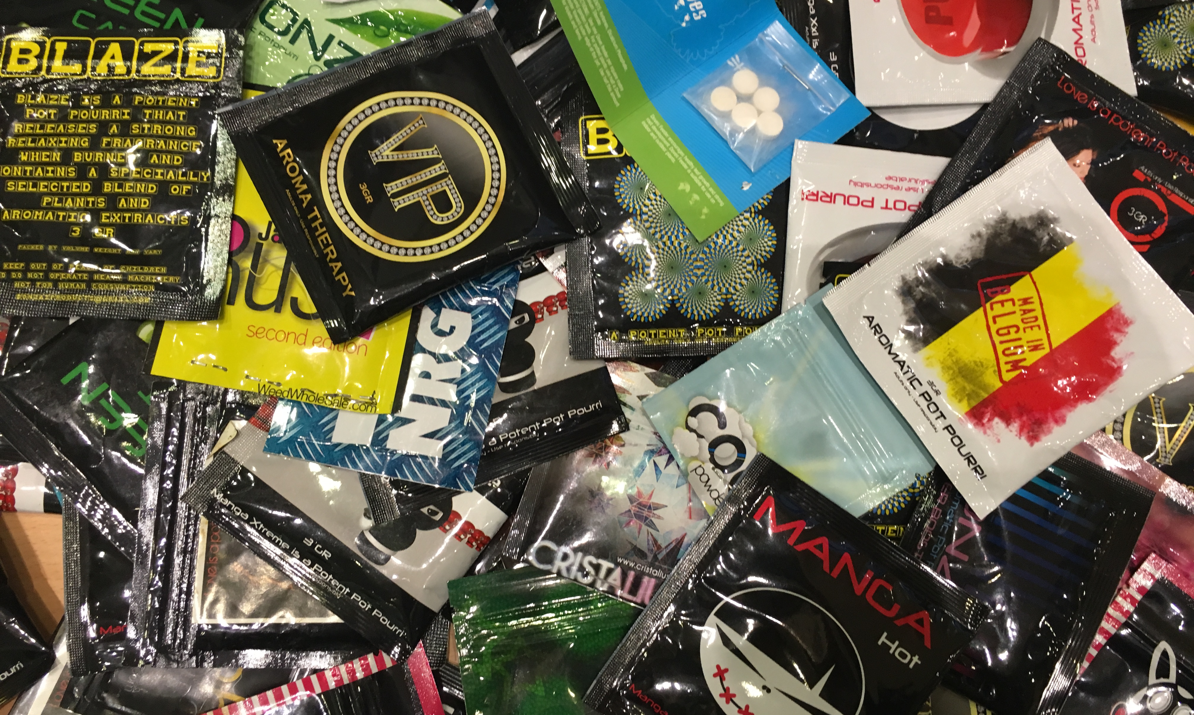
New psychoactive substances

Slide 40
Lifetime use of selected substances (percentage)
Notes:
Slide is double!

Slide 41
Wording of the NPS question
‘New substances that imitate the effects of illicit drugs (such as cannabis or ecstasy) may now be sometimes available. They are sometimes called ‘legal highs’, ‘ethno botanicals’, ‘research chemicals’ and can come in different forms, for example herbal mixtures, powders, crystals or tablets.’

Slide 42
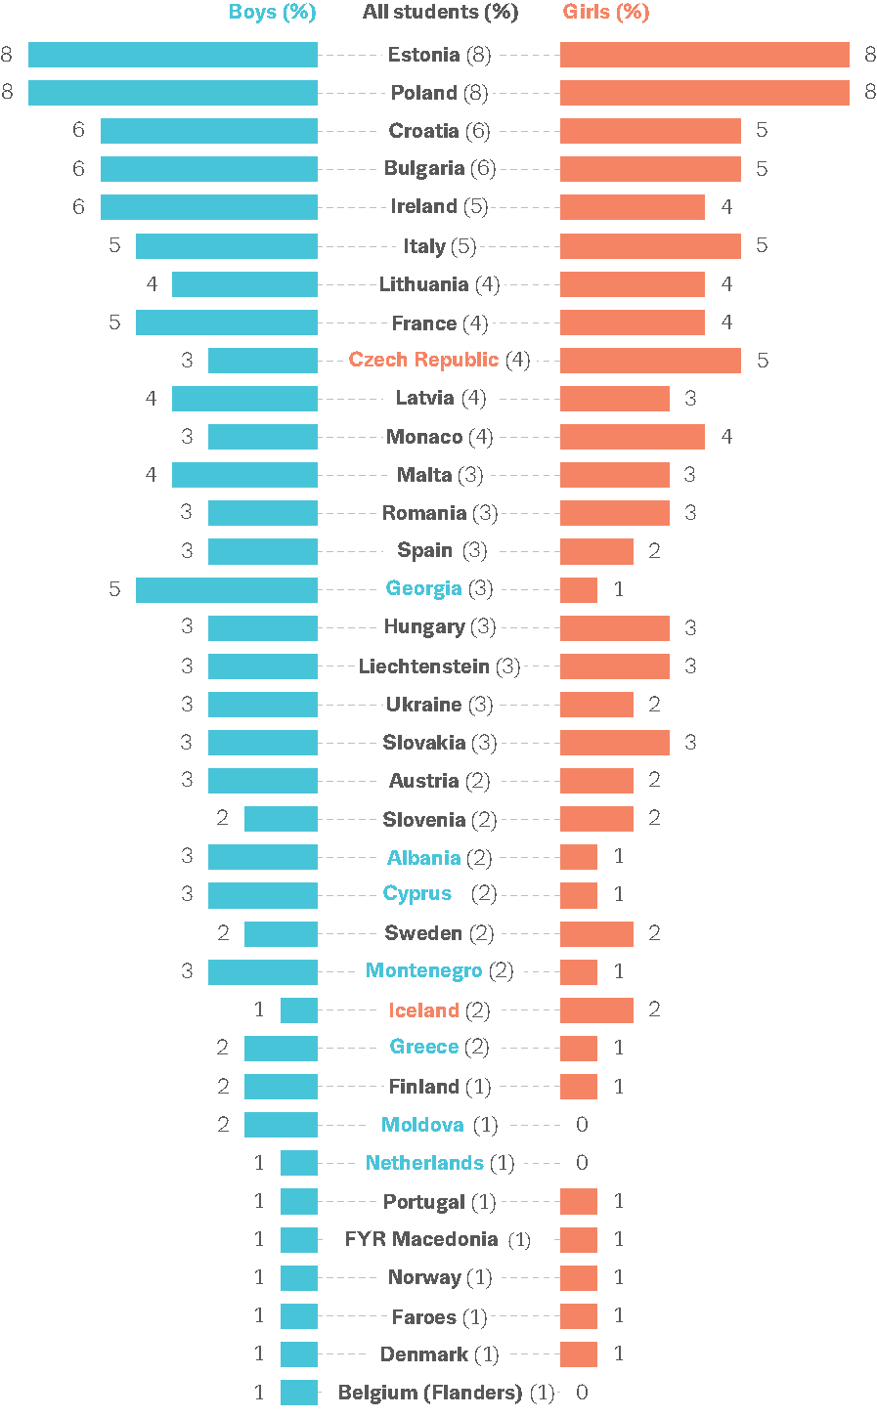
Prevalence of new psychoactive substance use in the last 12 months, by gender (percentage)
Notes:
The intention is not to read countries individually but to illustrate the range of variation of the values between countries

Slide 43

Internet, gaming, gambling

Slide 44
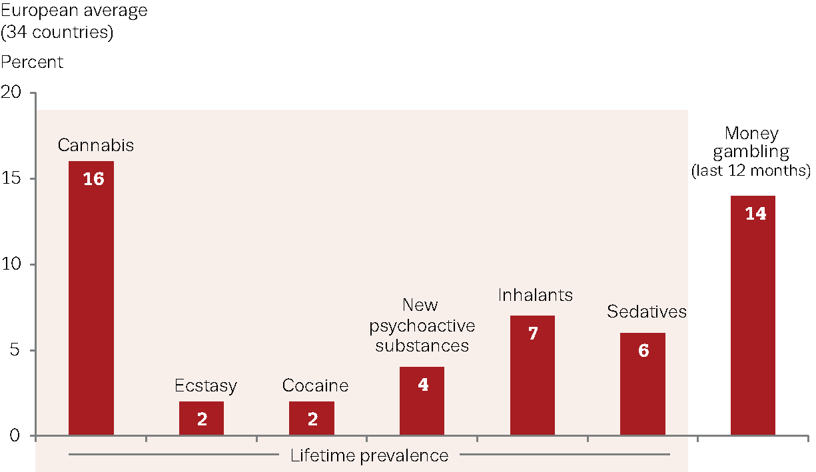
Lifetime prevalence of use of selected substances and gambling for money in the last 12 months (percentage)
Notes:
Here with gambling including to observe the relevant nature of the phenomena

Slide 45
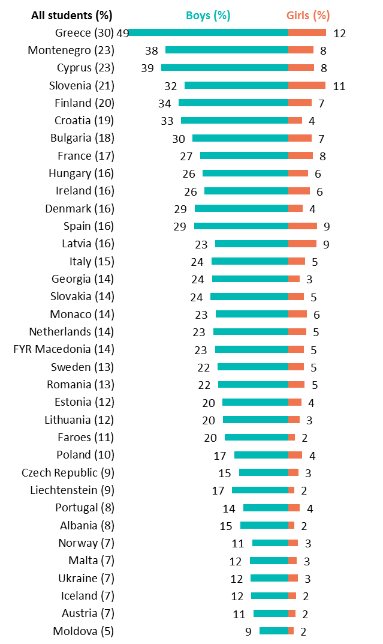
Gambling for money
Prevalence in the last 12 months, by gender (percentage)
Notes:
The intention is not to read countries individually but to illustrate the range of variation of the values between countries, and in this case particularly by gender

Slide 46
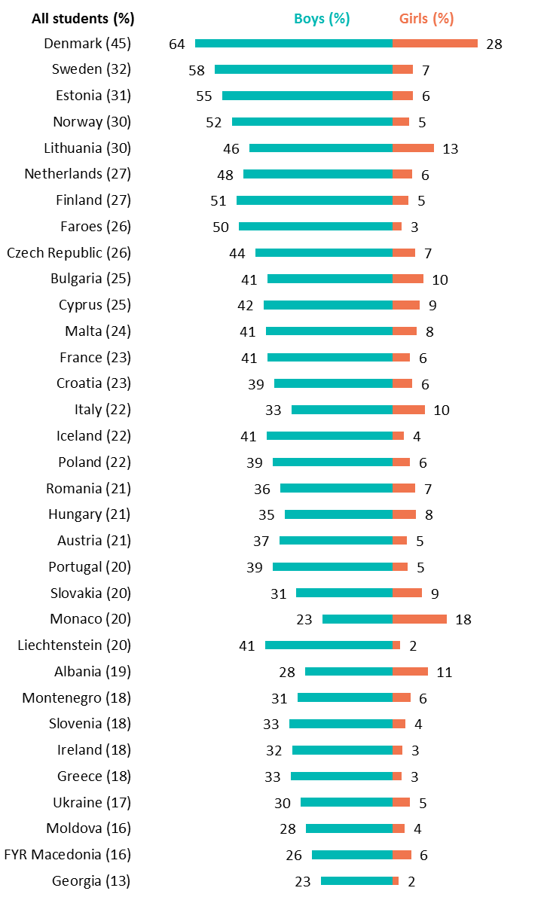
Prevalence of gaming on the internet
On 4 or more days in the last 7 days, by gender (percentage)
Notes:
The intention is not to read countries individually but to illustrate the range of variation of the values between countries, and in this case particularly by gender

Slide 47
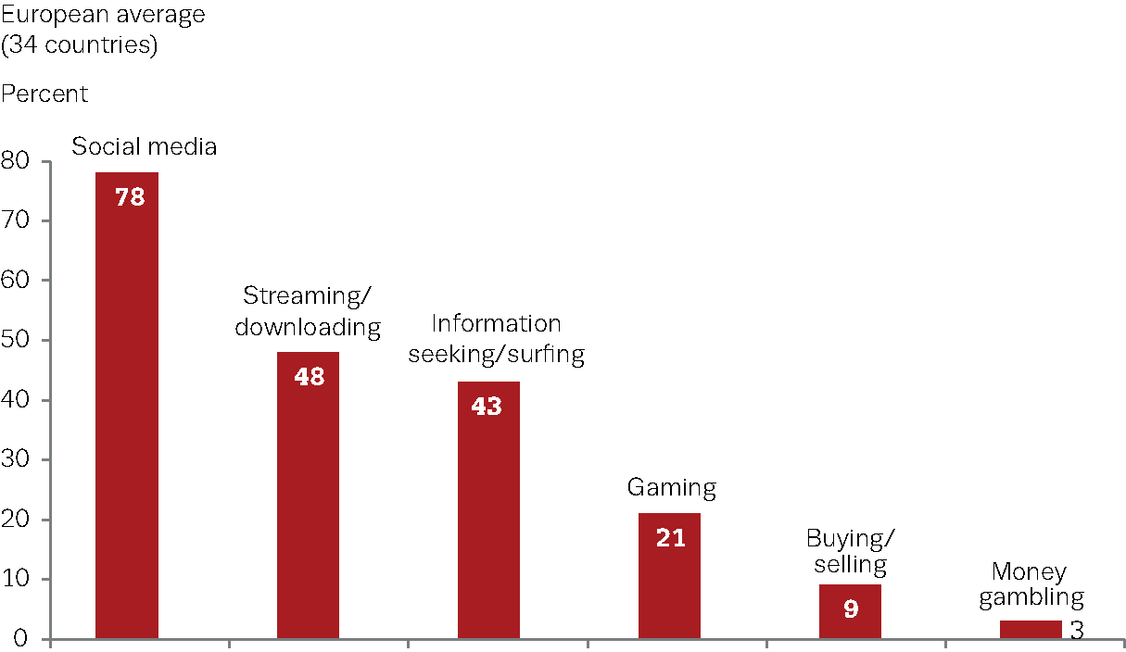
Prevalence of activities on the internet
On 4 or more days in the last 7 days (percentage)
Notes:
On average, the students reported use of the internet on 5.8 days within the last 7 days

Slide 48
ESPAD@emcdda.europa.eu
Available
    Electronically:
    (PDF and html)
    Download at:
    www.espad.org
    Hard copies:
    - Order from the EMCDDA
    emcdda.europa.eu
    - Order from EU Bookshop
    bookshop.europa.eu

Slide 49
In summary
    Smoking and drinking show signs of decline
    Concerns over new drugs and
    new addictive behaviours
    Tobacco decreasing, but availability still high
    Positive developments in alcohol use
    Heavy episodic drinking still reported by a
    third of students
    Availability of alcohol continues to be high
Notes:
Heavy episodic drinking still reported by a third of students despite improvement between 2011 and 2015

Slide 50
Continuation
    Illicit drug use stabilised, albeit at high levels (18%)
    Cannabis accounts for most illicit drug use
    30% of students find cannabis easily available
    Use of other illicit drugs is much lower than cannabis
    4% of students reported ever using
    new psychoactive substances
    Online gambling reported by a substantial proportion
    of students (23% of boys and 5% of girls)
Notes:
- Illicit drug use stabilised after increases between 1995 and 2003, but at high levels (18%)
- 4% of students reported ever using (LTP) new psychoactive substances (more than most illicit drugs other than cannabis)
- LYP for online gambling

Slide 51
Electronic version of the report with:
- additional methodological information
- additional figures and tables
- extraction of customised data
www.espad.org
Contact — ESPAD@emcdda.europa.eu

