Slide 1
GamCare Toolbox: psychosocial interventions
Conversation Basics
Node Link Mapping
Identifying strengths and resources
Goal planning
Building self esteem
Social network building
Life skills training
Cognitive behavioural therapy

Slide 2
The Psychosocial Approach
Motivational Interviewing
Cognitive Behavioural Therapy
Node Link Mapping
Social Network Building
Goal Planning
Life Skills Training
Self Esteem Building
Peer Support
The Psychosocial Approach

Slide 3
1. A recovery based approach
Core competencies:
Understand our Model of Care
Assess the needs of problem gamblers and affected others
Show empathy and active listening
Use FRAMES and OARS whilst delivering interventions
Offer practical advice on limiting time, access and money
Signpost to GamCare web based self-help
Signpost/refer clients as needed including debt advice, GamCare treatment, GA, FAMANON
Provide appropriate information and advice
Deliver a range of evidence-based interventions according to need
Deliver psychoeducation on cognitive distortions
Identify how gambling related harms can increase risk
Identify and manage risk and safeguarding issues
Response appropriately to suicidal ideation
Agree treatment goals
Deliver psychosocial intervention
Covered in Safeguarding training
Competency for Practitioners only

Slide 4
Conversation basics
Here we provide you with a framework for the basics that should underpin an initial conversation with a service user.
These basics should enable you to identify the problem and determine the appropriate intervention

Slide 5
Conversation basics: Activity
In pairs, roleplay an initial conversation between a professional and a service user:
Professional: use the conversation basics framework to lead the conversation
Service user: use the character card to make the call as the service user in your example

Slide 6
Mapping as a tool
What is it?
Using visual representations – e.g. diagrams, flowcharts, to capture and explore the client’s situation
What are the benefits?
Great at capturing circular thinking, feedback loops and links
Proven to reduce barriers that distort communication
Make treatment discussions more memorable
Can focus clients on key areas
Easy to share record of discussion with supervisors

Slide 7
Mapping as a tool
Ideas / thoughts in a box: ‘nodes’
Write and draw together
Links (named or not) show the relationship between nodes
Node
Explore the links.
How are the nodes linked?
What do the links mean?
Explore and unpack each node

Slide 8
Mapping as a tool
Free Maps: service user and professional build a map from scratch
Guide Maps: service user fills in a pre-formed map
Hybrid Maps: service user begins with a guide map but expands out freely

Slide 9
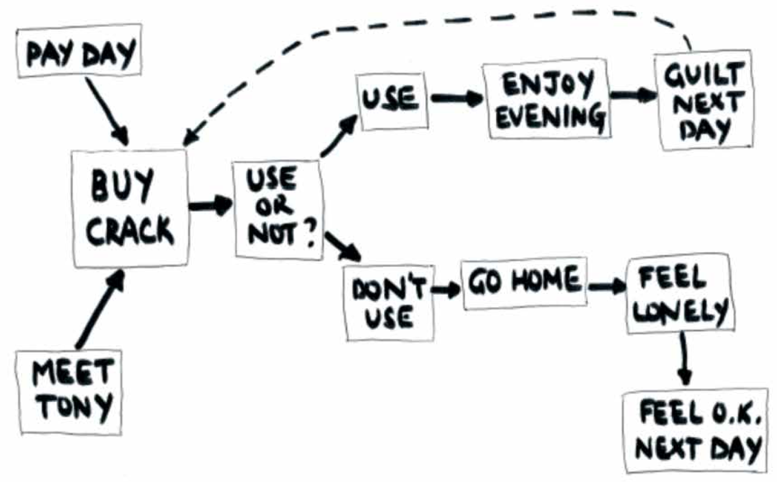
Free map
Free map created during a session on drug relapse – ‘Routes to Recovery’

Slide 10
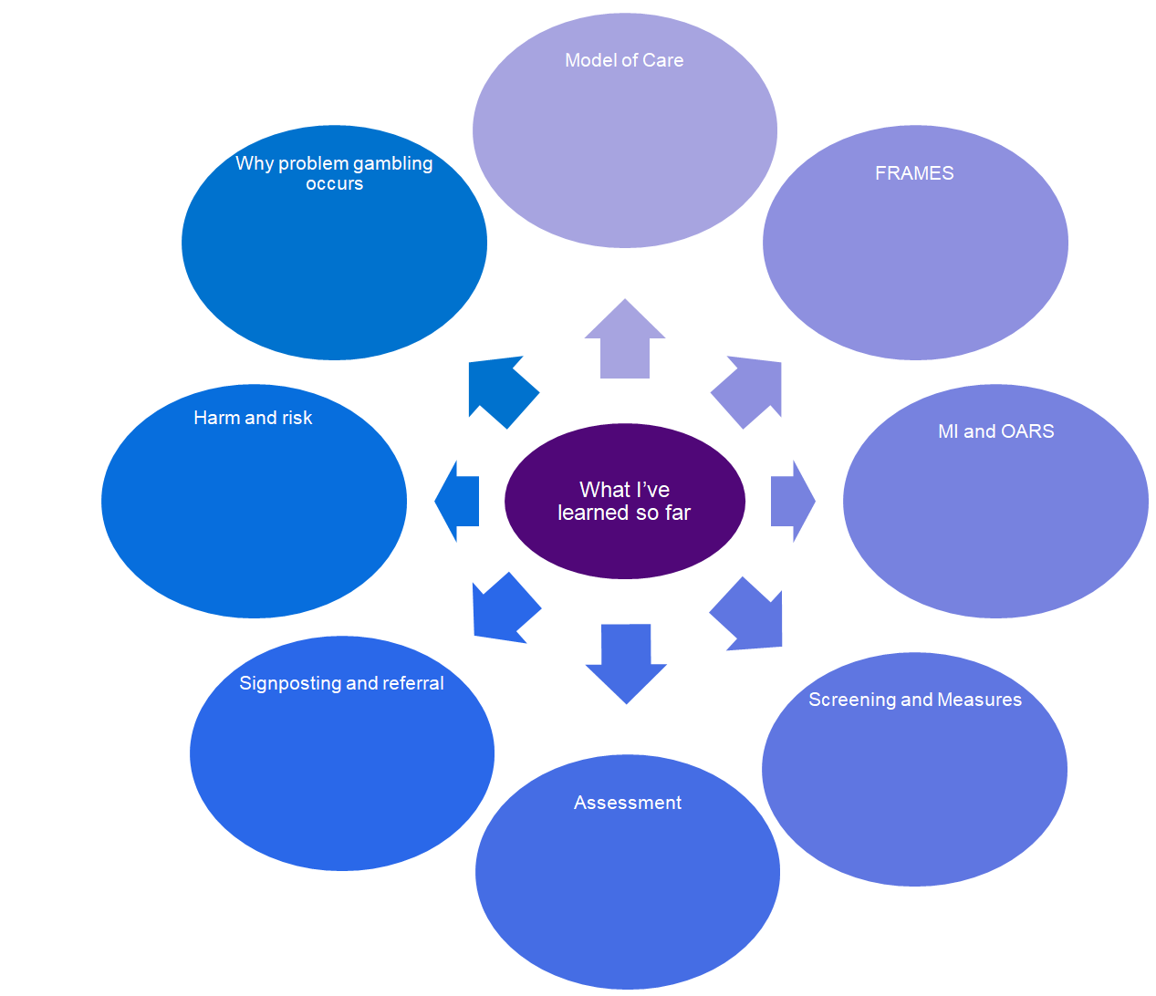
Guide map
GamCare: tier 2 & 3
Socioeconomic, mental health, etc...
Remember to Listen reflectively!!
Link everything to risk!
Use the convo basics for calls

Slide 11
Hybrid map
Strengths & Resources
Traits & characteristics
Need to build more strengths:
- Resilience
- Patience!!
- Assertiveness
How do I do this?
Support
Skills
Family & friends

Slide 12
Identifying Strengths and Resources

Slide 13
Identifying Strengths and Resources
Assessment can often focus on negative aspects of a person’s life.
However it is possible to organise the assessment process to maximise discussion of ‘recovery capital’ in order to empower the client to develop their own recovery plan.

Slide 14
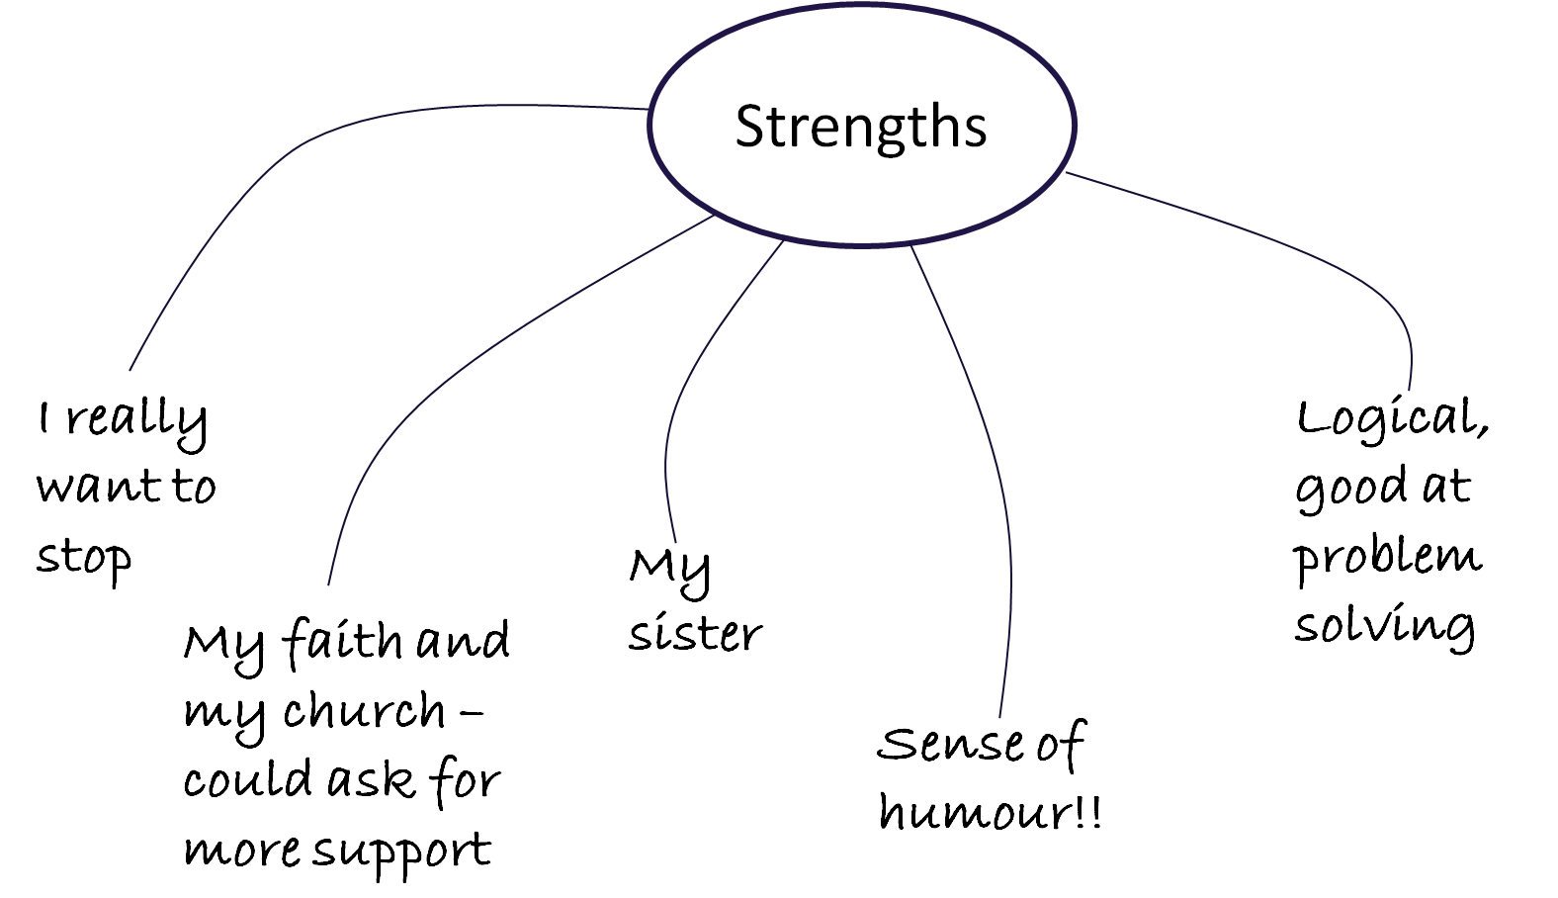
Strengths map

Slide 15
Strengths and resources map
Strengths & Resources
Characteristics
Knowledge
Relationships & social
Values & beliefs
Problem solving/coping
Health & physical
Skills & work

Slide 16
Identifying Strengths and Resources: map
Work in pairs to build a free map exploring your colleague’s strengths
As you build the map:
Explore how they can use their strengths more effectively in their lives
Identify if there are any other strengths they want to build

Slide 17
Goal Planning: detail map
My Goal:
Specific Actions
When will you do each action?
Helpful people & thoughts
Strengths you have or need
Possible problems:
Solutions:

Slide 18
Reviewing goals
Review goals at least monthly
Celebrate and examine successes: what did the service user do to make it happen?
Explore unsuccessful attempts: what got in the way? What can they learn from this attempt? What will they do differently next time?
Re-set goals and actions and set next review point

Slide 19
Blocked goals and self efficacy
Increase self efficacy by:
Looking at blocked goals
Identifying what is blocking change
Problem solve ways to overcome the blockage
Aim: to build belief that service user has control and can make things happen, and is empowered to try new things

Slide 20
Blocked goals and self efficacy
Goal being blocked:
What are the skills required and what strengths do you have?
How have you achieved similar things?
Who can be recruited to help?
What is the block to achieving the goal?
What can you learn from this?
Can it be broken down into tasks?
Alternatives to my block are…

Slide 21
Building Self Esteem
Using maps to build self esteem

Slide 22
Building self esteem
Aim: to build a core of self esteem that is not linked to the successes and failures of every day life
Increase self esteem by:
Challenging negative self talk
Practice self care
Reminders of strengths and achievements
Seeking support from others
Doing fun or relaxing things

Slide 23
Building self esteem: Activity
Things I can do to improve my self esteem
Ways I can look after myself
What are my strengths and achievements?
Things I can do to treat myself when I’m feeling down
Who can I talk to for support
Things I can say back to my inner critic

Slide 24
Social network building
Recovery is a social process
Recovery is based on the power of community: the more people are helping you, the more likely you are to succeed
Building social support for change boosts the individual’s recovery capital outside of the formal treatment environment
People are influenced in thinking and actions by the people surrounding them, and they learn how to recover by copying others who have achieved recovery themselves

Slide 25
Social network building
Our role
Discuss and explore service user’s social network
Encourage them to develop a support system
For Practitioners: discuss whether it is useful to invite a supportive, appropriate person to a session
Help them find community groups or recovery to be part of

Slide 26
Social network building
Involving family members (practitioners only)
Early on, ask the service user if there is a supportive person they would like to bring to a session
Rehearse the invitation or provide support by phoning/email/text together in the session
Make it clear that this is not family therapy. The aim is to identify how this person can best help the service user in their recovery journey.

Slide 27
Social network building
Community and recovery-based groups
Have a comprehensive list of local groups
Know their requirements and how each group works
Discover the service user’s interests
Talk through any negative perceptions to joining recovery or general groups
Importantly: be the bridge - help with integration

Slide 28
Life skills training
How might developing these skills aid recovery?
Time management / organisational
Financial
Communication / social
Assertiveness
Managing emotions
Problem solving
Stress management / relaxation

Slide 29
After care (Practitioners only)
Skills consolidation
Action planning

Slide 30
After care
At the end of treatment, it’s important to think about what the client needs to support their recovery in the future.
Transitioning from a series of treatment to owning their recovery themselves can be a difficult time for clients.
While the risk of relapse will diminish over time it will not go away completely.

Slide 31
After care
Level of intervention | After care examples
Brief interventions | Information about mutual aid
Extended brief interventions | Referrals Monthly check up sessions / calls / emails
Psychosocial treatment | Consolidating skills learned in treatment Relapse prevention work
Relapse / at risk of relapse | Action planning Monthly check up sessions / calls / emails Referrals Mutual aid

Slide 32
After care – skills consolidation
For those who’ve undergone tier three treatment with psychosocial interventions, prepare for aftercare by helping to consolidate the skills learned in treatment.
What have they learnt?
How have they changed?
How have they overcome obstacles?
What do they need to keep working at?

Slide 33
After care – action planning
Help the service user build a picture of their life in recovery and set goals together:
Clarify priorities
Build positive routines, e.g. new hobby/job
Practice good self care
Agree recovery rituals
Outline a relapse prevention plan
Reminder of their strengths and resources
Set them up with a Recovery Weekly Review

Slide 34
After care – action planning
Week beginning:
Recovery Area | Success | Rough spots | Lessons learnt | What to do now?
Not Gambling
Self Care
Positive relationships
Increasing hobbies
What else for them? What else is important?

Slide 35
Self care
The ABC of self-care
Self care in practice
Stress management: the lifeboat

Slide 36
Self Care
Awareness
Attune
Practice
Balance
Have a personal life
Connection
To yourself
Know
Accept
Enjoy activities
To others
To the bigger picture
To the idea that you don’t have to do this alone
The ABC of Self Care (Saakvit & Pearlman 1996)

Slide 37
Self Care
Physical?
Emotional?
Psychological?
Spiritual?
Professional?
How can we practice self care in these areas?

Slide 38
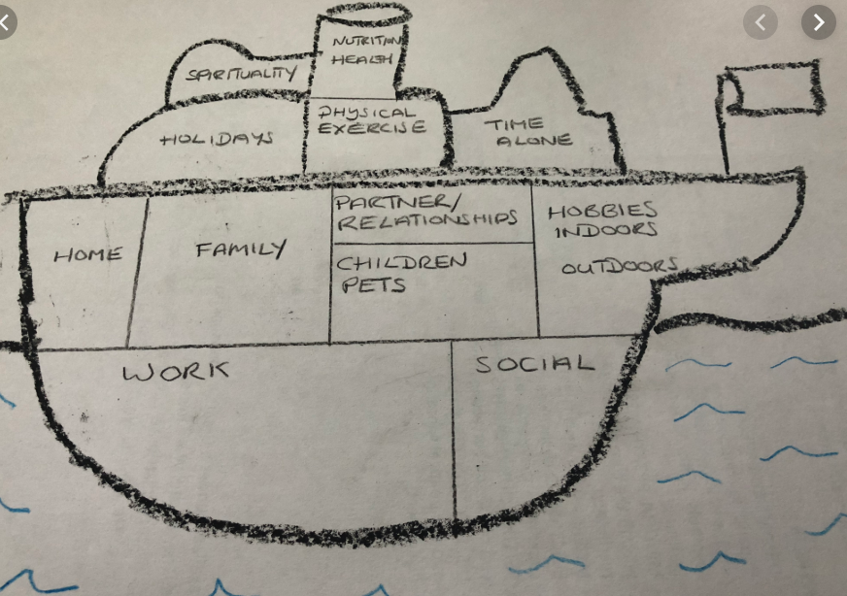
Self Care
Lifeboat to be replaced with new image.

Slide 39
Self Care
Five career sustaining behaviours
Maintain sense of humour
Spend time with partner/family
Maintain balance between professional and personal lives
Maintain self-awareness
Maintain sense of control over work responsibilities

Slide 40
Professional Development
Your new workbook
First three months in the role

Slide 41
Summing up

Slide 42
How is everyone feeling?

Slide 43

Did we achieve our goal today?
Goal:
Build understanding and application of a range of psychosocial interventions to build a holistic approach to recovery.

Slide 44
Summary: Activity
A recovery based approach: focusing on individual strengths, positive identify and self-efficacy
Safe, effective services: identification and management of harm and risk
Service user choice: providing relevant information and respecting service user autonomy
Evidence based practice: well-researched techniques based on psychosocial intervention
Stepped care: the right service at the right time

Slide 45

Debrief and Feedback

Slide 46
END OF DAY THREE

